Slide 1
Lamarckian NeuroEvolution
Integrating Q-learning backpropagation with NEAT produces better results than either on their own in Flappy Bird

Slide 2
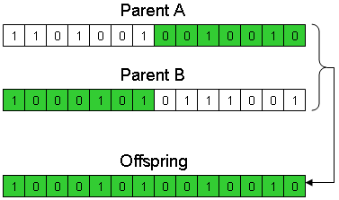
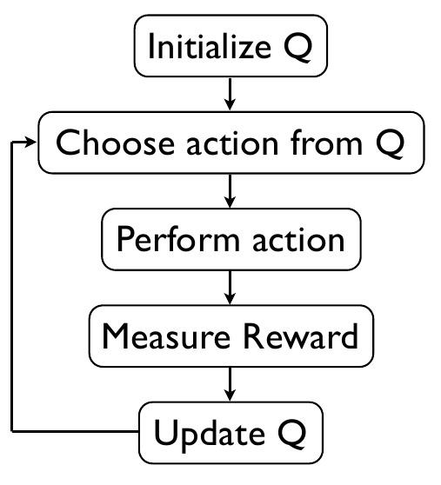
Background
NEAT, invented by Stanley and Risto in 2002, used a genetic algorithm to combine the best neural networks, requires no foreknowledge of optimal neural network topology
Q Learning, invented by Watkins in 1989, describes a method reinforcement learning method easily applicable to deep learning with backpropagation
The two have not been used together until now

Slide 3
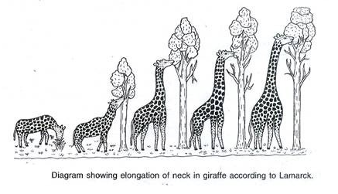
Approach
Combine NEAT with Q learning by running backpropagation on each neural network as the results of the reward function become known prior to genetic recombination
Compare results to NEAT and Q learning by themselves

Slide 4
Results
NEAT Alone
Throughout 40 generations, achieved a score of 25 at most
Deep Q-Learning Alone
Could not score a single point within 40 iterations
Combining the Two
Achieved a score of 40 within 30 generations, 77 within 40

Slide 5

Explanation
Deep Q-Learning requires a-priori knowledge of good architectures
NEAT can search a much wider state space than Q-Learning alone
Q-Learning better finds local optima than NEAT, but also can get stuck in local optima

